Slide 1
MINI PROJECT BANKING APPLICATION
NAME : C PRIYADHARSHINI
ENROLL. NO : EBEON1222705676
BATCH NO : 2022-8644

Slide 2
outline
Aim of the project
Background details
Purpose
Requirements
Application Description
Modules Description
Compilation
Welcome screen
Main menu

Slide 3
AIM OF THE PROJECT
The main aim of designing and developing this Internet banking System java based project is to provide secure and efficient net banking facilities to the banking customers over the internet.
Apache Server Pages, MYSQL database used to develop this bank application where all banking customers can login through the secured web page by their account login id and password.
Users will have all options and features in that application like get money from western union, money transfer to others, and send cash or money to inter banking as well as other banking customers by simply adding them as payees.

Slide 4
PURPOSE
To develop a software for solving financial applications of a customer in banking environment.

Slide 5
system requirements
Hardware Requirements
Software Requirements

Slide 6
Application description
The Bank management system is an application for maintaining a person's account in a bank.
The system provides the access to the customer to create an account, login, etc.
Deposit/withdraw the cash from an account, also to view report of the account.

Slide 7
Module description
Mani Menu
1.Create an account
2.Login account
3.Delete account
Client Menu
1.Deposit
2.Withdraw
3.Transfer Money
4.Balance Check
5.Exit

Slide 8
compilation
Create Byte code
Run the Byte code

Slide 9
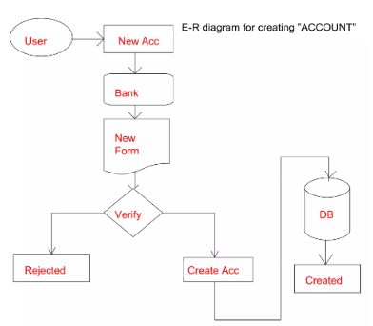
E-r diagram for create account

Slide 10
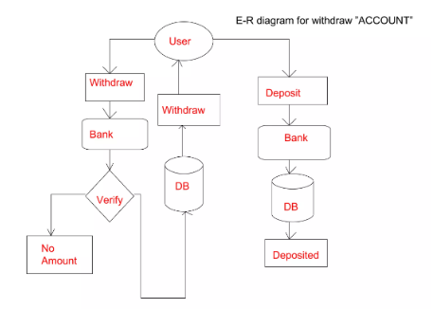
E-r diagram for withdraw

Slide 11
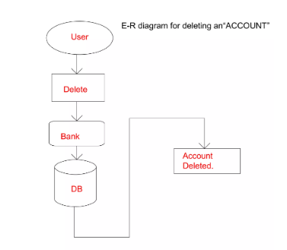
E-r diagram for delete account

Slide 12
Database setup
Step 1: Create Database indian_bank
Step 2: Create Table name user
CREATE TABLE `user`( `ac_no` int DEFAULT NULL UNIQUE KEY , `user_name` varchar(45) UNIQUE KEY DEFAULT NULL,`balance` int DEFAULT NULL,`pass_code` int DEFAULT NULL);

Slide 13
ECLIPS PROJECT SETUP
Create New Project
Create A package name banking

Slide 14
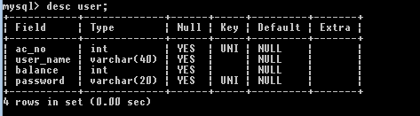
Mysql table Creation

Slide 15
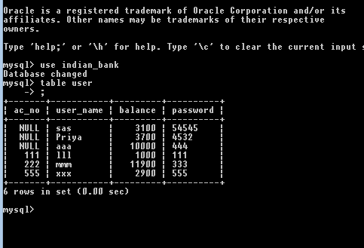
Mysql output

Slide 16
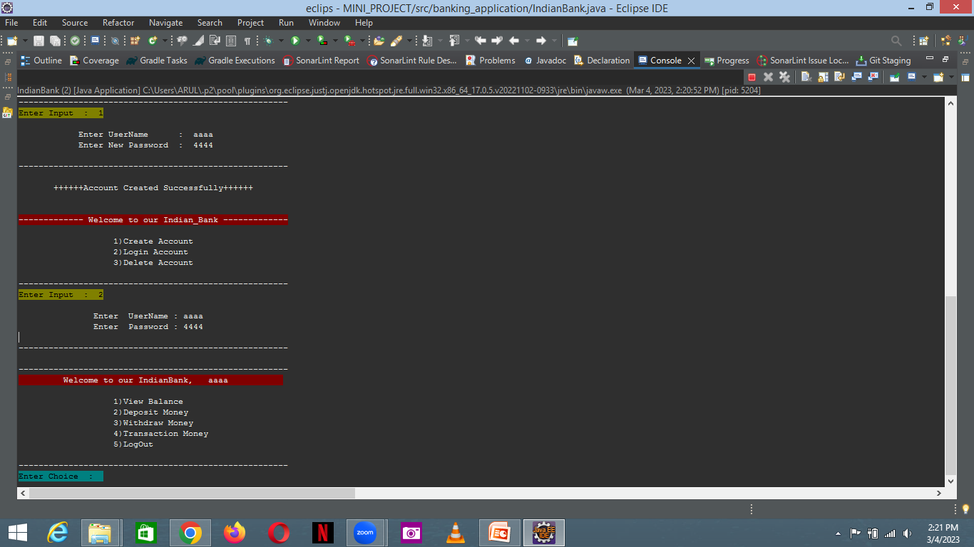
Create and login Output
Entering name , password
Account created message
To be entered choice option and login account

Slide 17
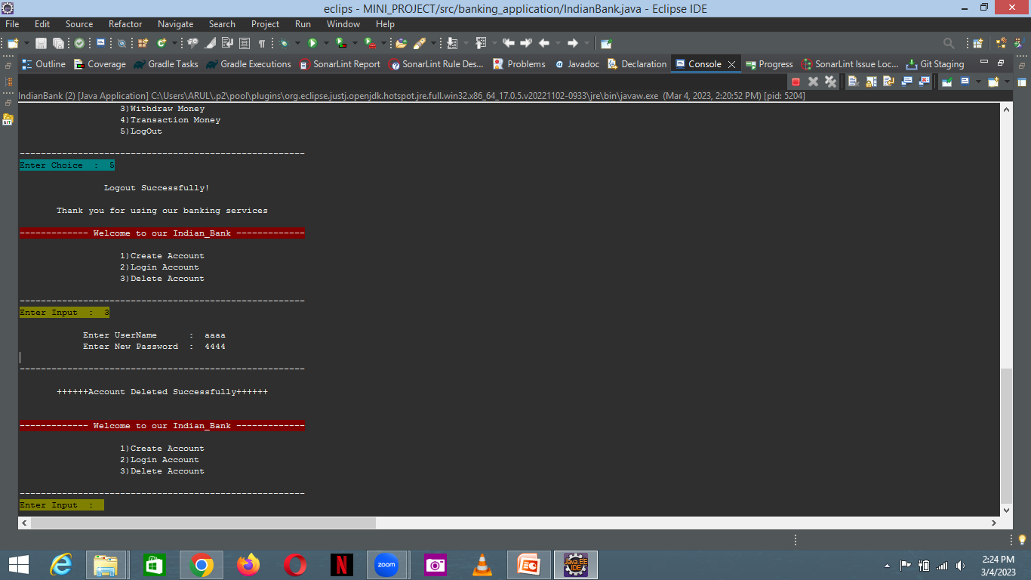
Delete account
To be entered choice for delete and username and password
Deleted message

Slide 18
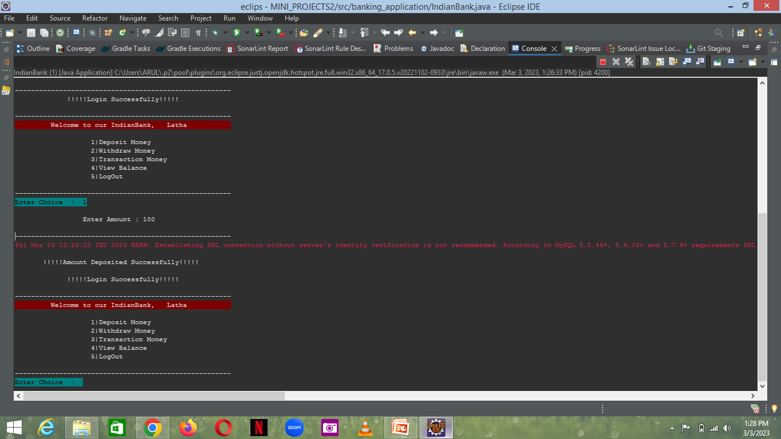
DEPOSIT
To be entered choice for deposit and
Entering amount
Debited message

Slide 19
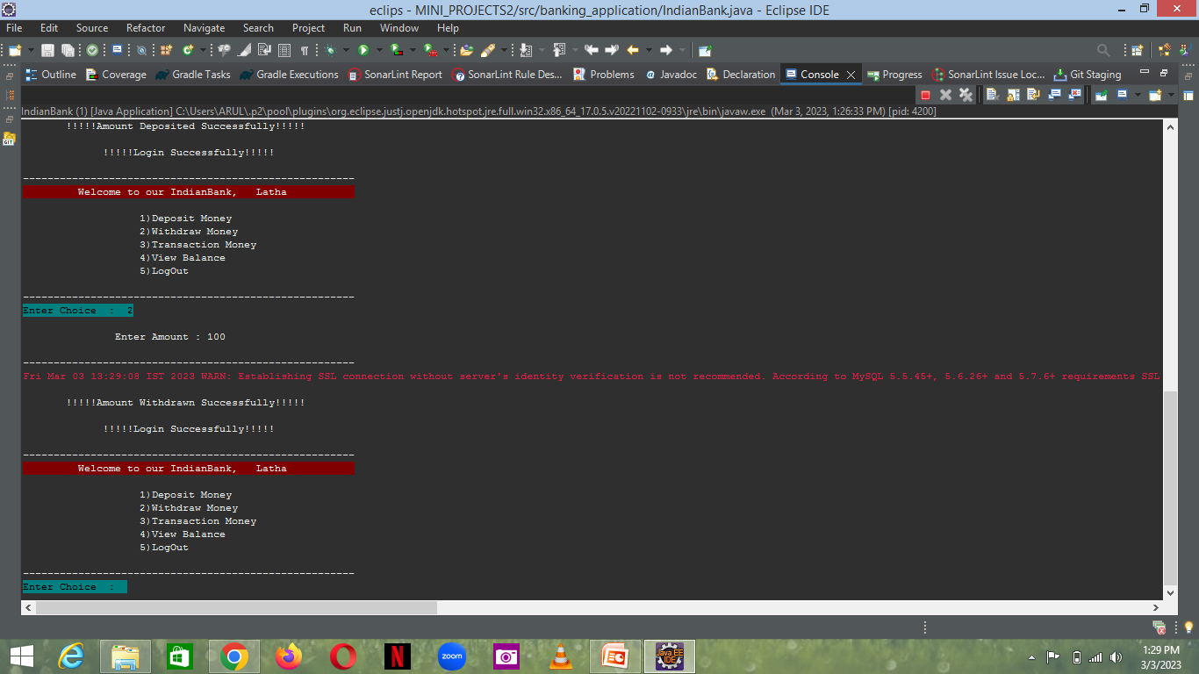
withdraw
To be entered choice for withdraw and
Entering amount
Withdrawn message

Slide 20
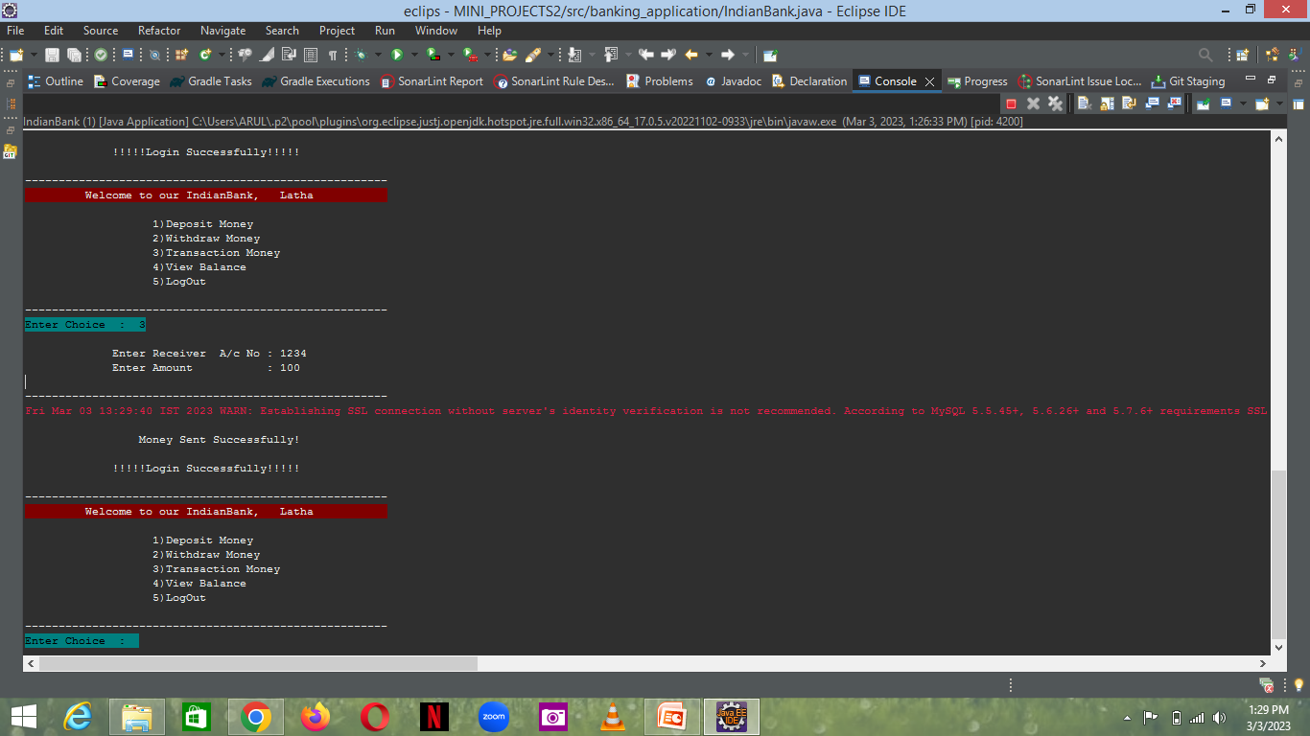
Transfer money
To be entered choice for transfer money and entering receiver account number and
Entering amount
send message

Slide 21
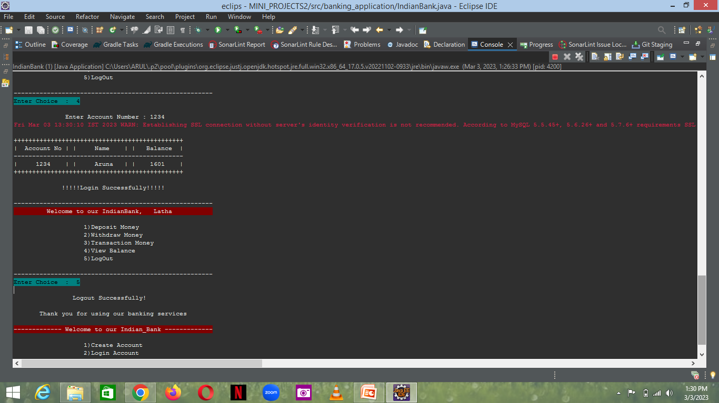
Balance check
Display details

Slide 22
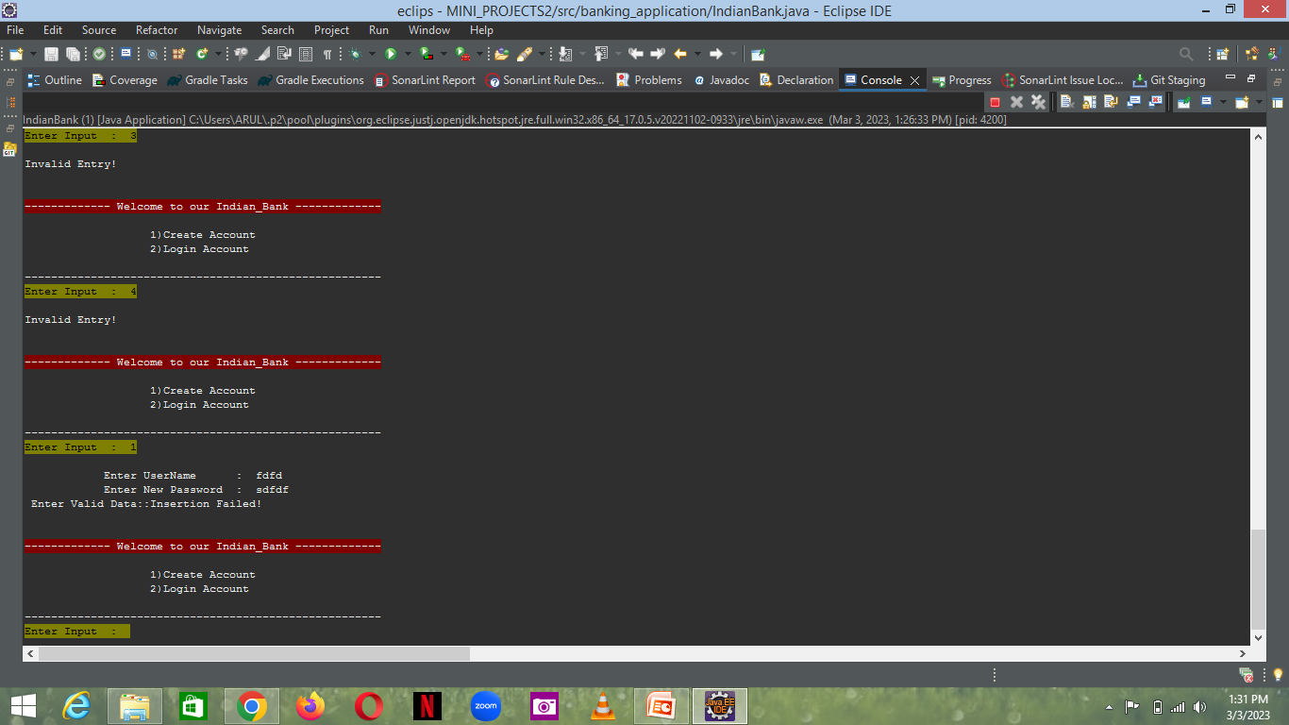
Invalid error
To be entered choice wrongly
To be entered username and password wrongly
Error message

Slide 23
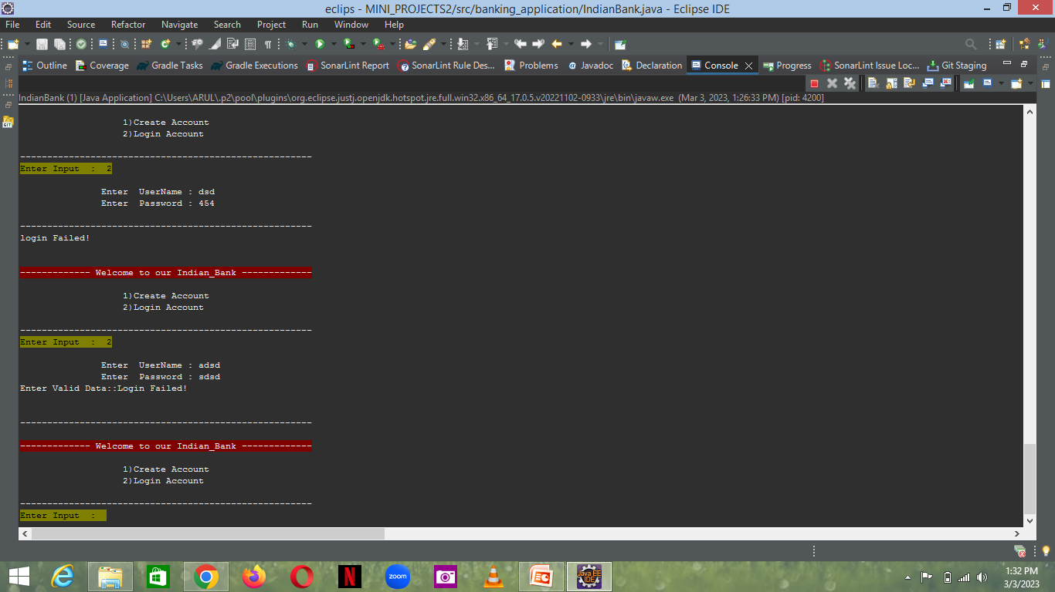
Login error message
To be entered username and password wrongly
Error message

Slide 24
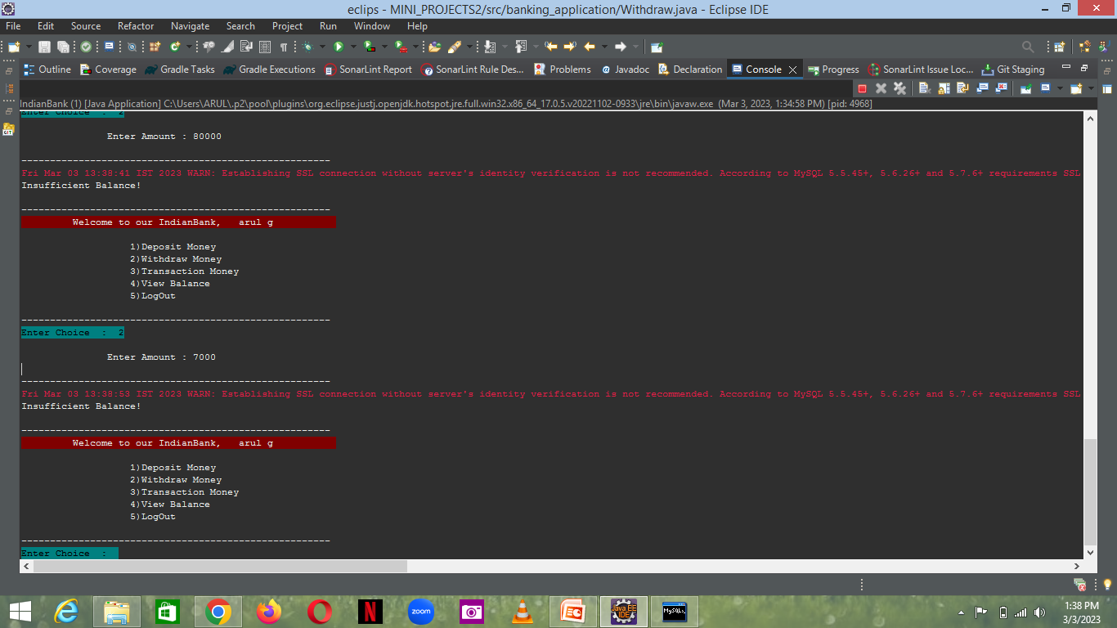
Withdraw(error)
insufficient message

Slide 25
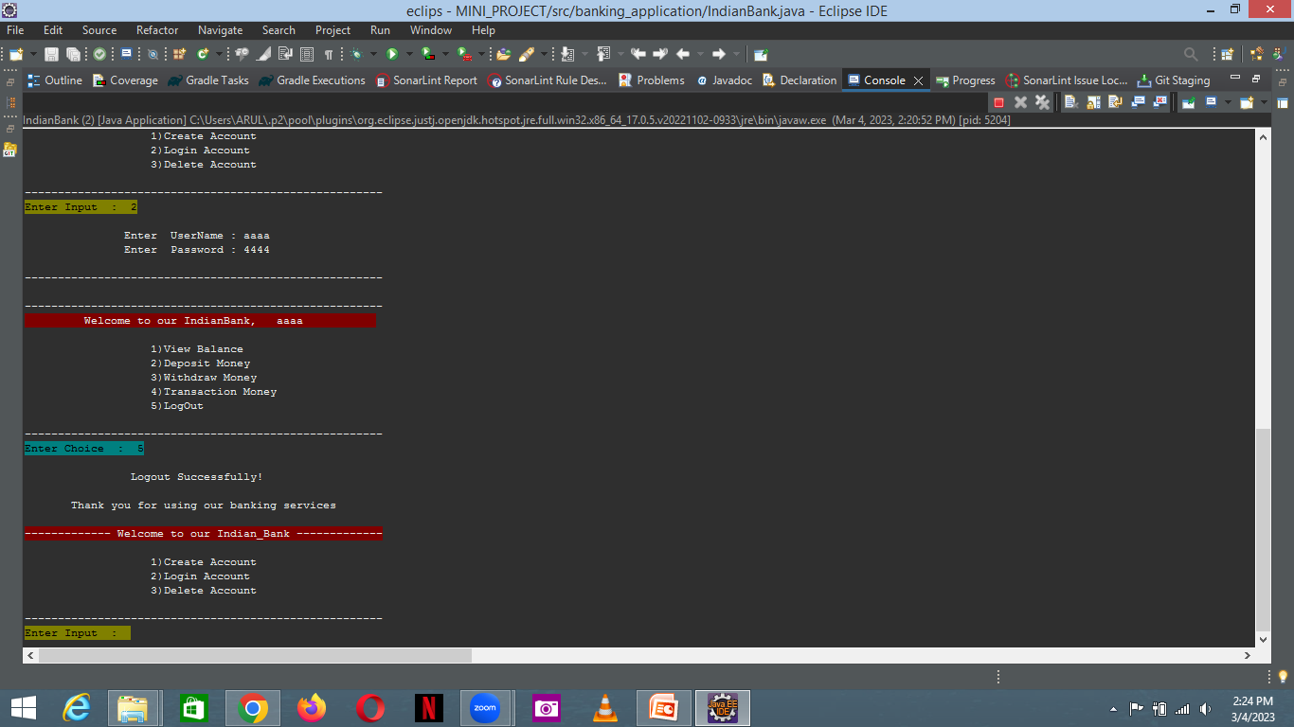
logout
logout message

Slide 26
advantage
Easy to operate.
Using simply some classes, objects, functions, etc.

Slide 27
conclusion
This project is developed to nature the needs of a user in a banking sector by embedding all the tasks of transactions taking place in a bank.

Slide 28


